Slide 1
PAST CONTINUOUS
BASIC 11 – UNIT 8a

Slide 2
Past Continuous
Use the past continuous to express an action that was in progress (not finished) in the past.
Allende was working for the United Nations. . .
. . . when she married her first husband in 1962.
1962
now
past
future

Slide 3
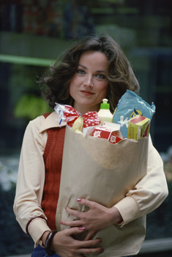
THE PRESENT CONTINUOUS AND THE PAST CONTINUOUS
It is 7P.M. now.
Alexis is shopping.
Yesterday at 7P.M.,
Alexis was shopping.

Slide 4
THE PRESENT CONTINUOUS AND THE PAST CONTINUOUS
PRESENT CONTINUOUS
(a) It’s noon now. Angie is eating lunch.
PAST CONTINUOUS
(b) I saw her at noon yesterday.
She was eating lunch.

Slide 5
THE PRESENT CONTINUOUS AND THE PAST CONTINUOUS
PRESENT CONTINUOUS FORM:
AM
+ -ING
(c) It’s noon. I am eating lunch.
IS
+ -ING
It’s noon. Jung is eating lunch.
ARE
+ -ING
It’s noon. We are eating lunch.

Slide 6
THE PRESENT CONTINUOUS AND THE PAST CONTINUOUS
PAST PROGRESSIVE FORM:
(d) It was noon.
WAS
+ -ING
Jung was eating lunch.
WERE
+ -ING
We were going to class.

Slide 7
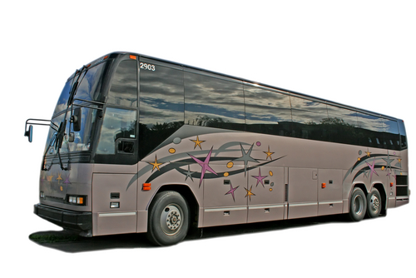

He ran to work yesterday.
He was running when the bus drove by.

Slide 8
THE PAST CONTINUOUS
X
X
(c) Edgar was running when the bus drove by.
(d) They were eating when I got home.
in progress
was/were + -ing

Slide 9
THE PAST CONTINUOUS
X
X
When the bus drove by, Edgar was running.
The bus drove by while Edgar was running.
when = at that time
while = during that time

Slide 10
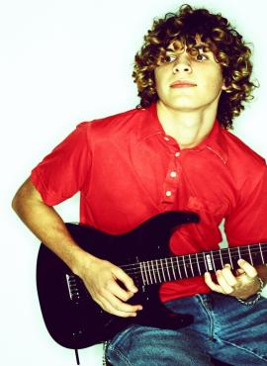
He wasn’t studying.

Slide 11
STATEMENT
I
She
He
It
You
We
They
was talking.
were talking.
NEGATIVE
I
She
He
It
was not talking.
You
We
They
were not talking.
wasn’t talking.
weren’t talking.

Slide 12
QUESTION
I
she
he
it
you
we
they
Was
talking?
Were
talking?
SHORT ANSWER
I
she
he
it
you
we
they
Yes,
was.
Yes,
were.
I
she
he
it
you
we
they
No,
wasn’t.
weren’t.
No,

Slide 13
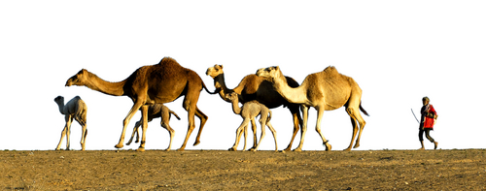
2-9 Let’s Practice
walk
were walking
Yesterday, the camels ___________
in the desert.

Slide 14
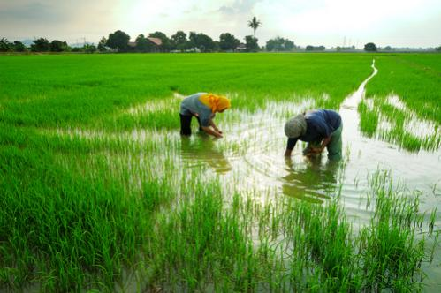
2-9 Let’s Practice
At 8:00, we began to work.
At 8:30, we ____________.
work
were working

Slide 15
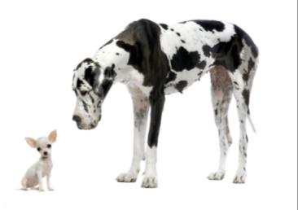
2-9 Let’s Practice
was looking
Spot __________ at Mac.
Mac _____________ at Spot.
look
wasn’t looking
Mac
Spot

Slide 16
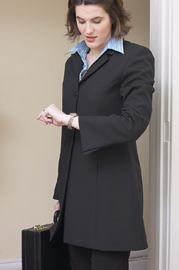
9-9 Let’s Practice
look
When I saw my teacher, she ___________ at her watch. She was late.
was looking
Notes:
Students are ready for Exercises 2 and 3 after this slide.

Slide 17
take
When I arrived, the students
__________the test.
were taking
Notes:
Students are ready for Exercises 2 and 3 after this slide.

Slide 18
sit
When the class started, he
_________ in his seat.
was sitting
Notes:
Students are ready for Exercises 2 and 3 after this slide.

